Slide 1
Exam Review

Slide 2
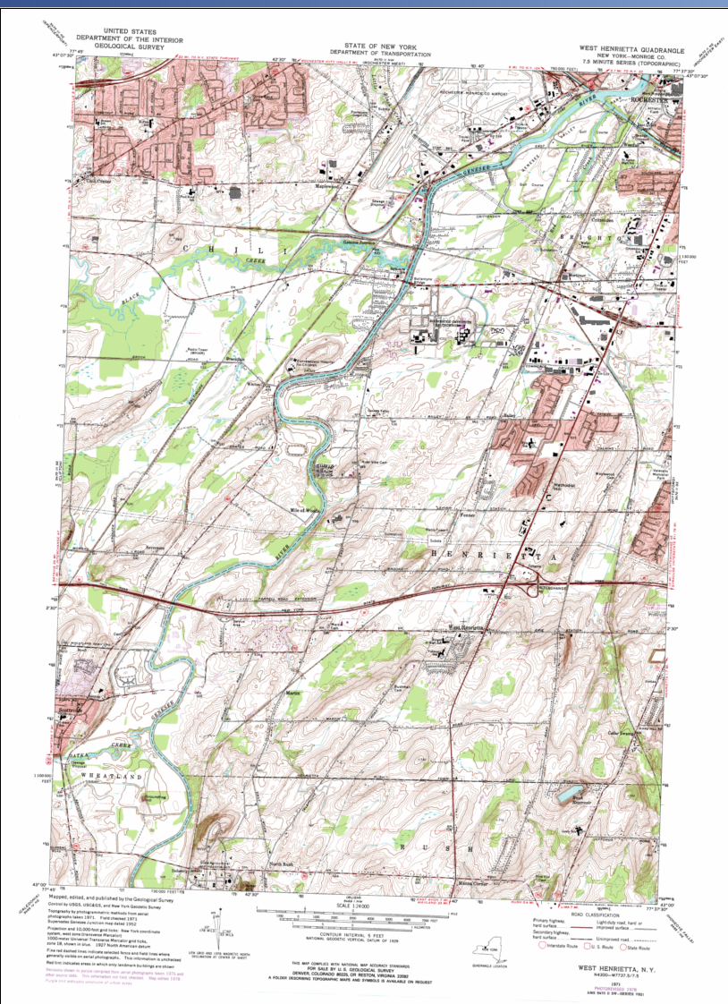
Reference Map
Numerous features
No specific information being shown

Slide 3
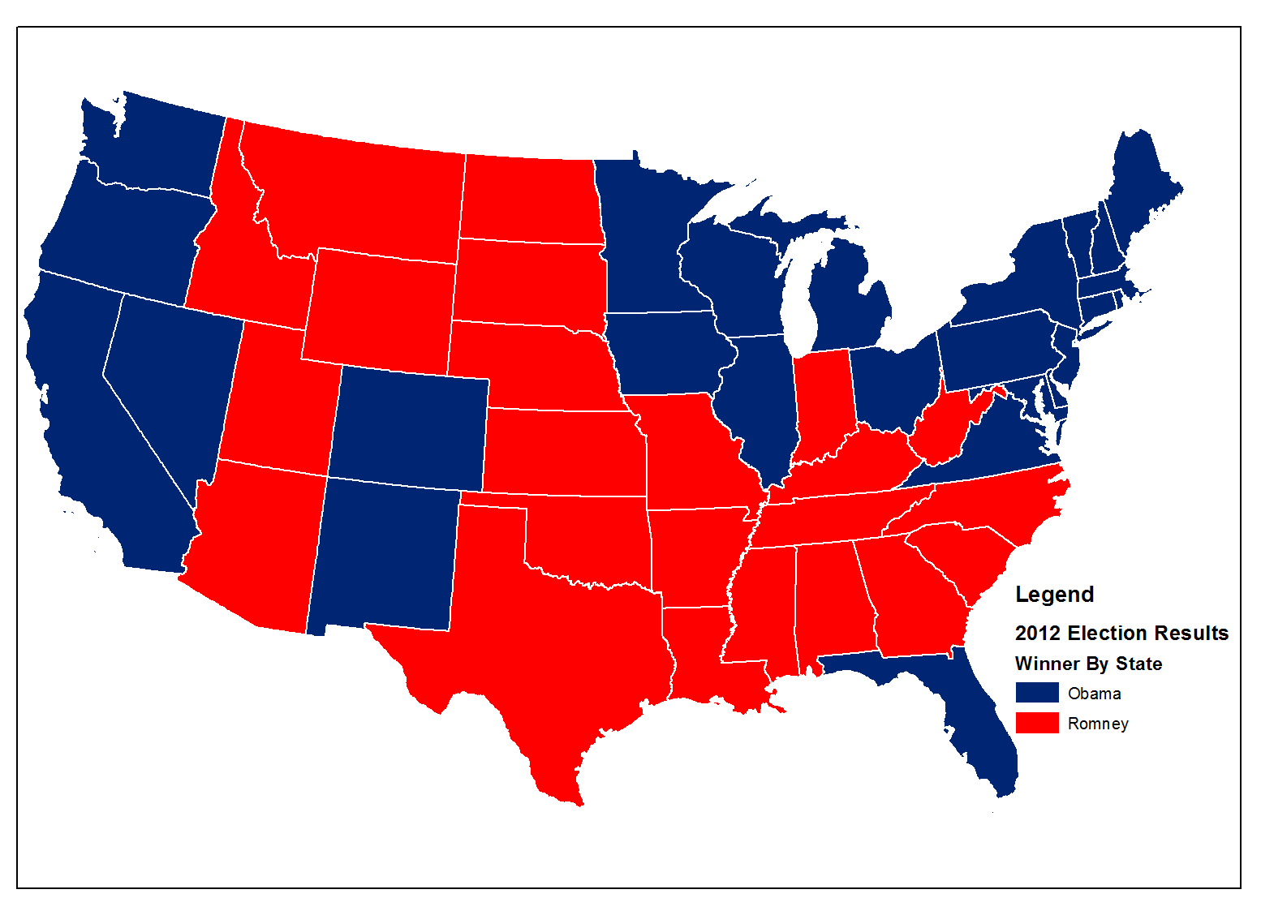
Thematic Map
Distributions of a single attribute
Relationships among several attributes
© 2013 B. Tomaszewski

Slide 4
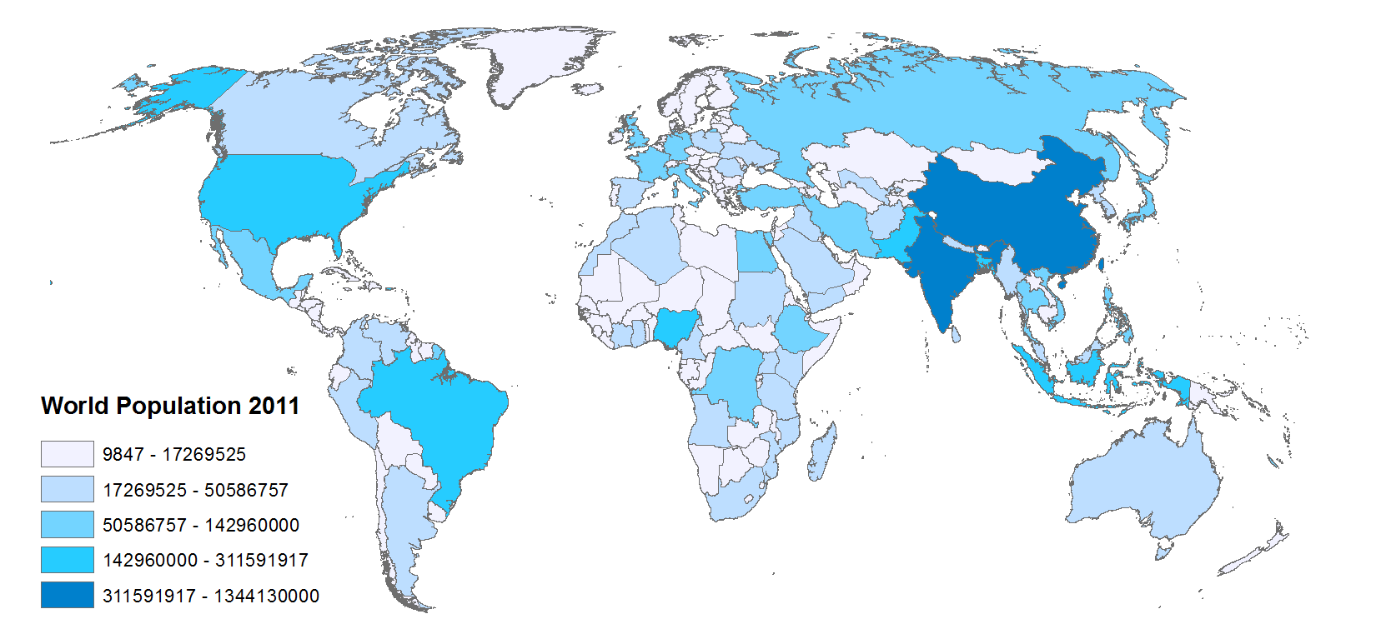
Choropleth Map
© 2013 B. Tomaszewski

Slide 5
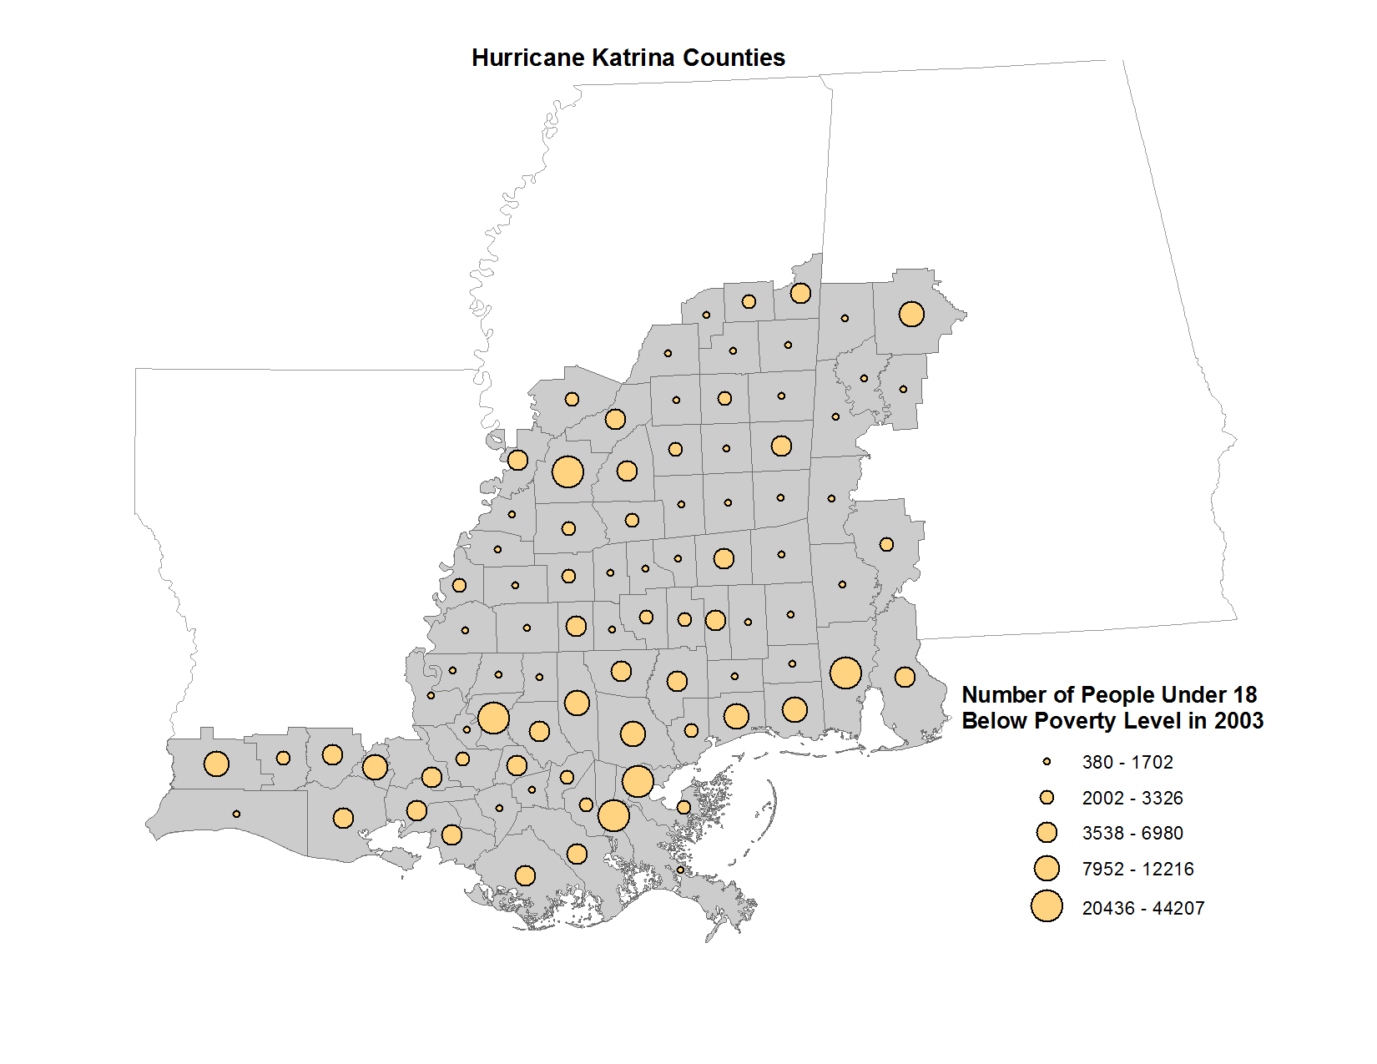
Proportional Symbol Map

Slide 6
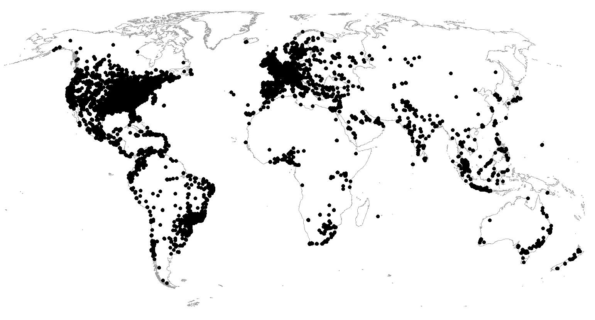
Dot Density Map
© 2013 B. Tomaszewski

Slide 7
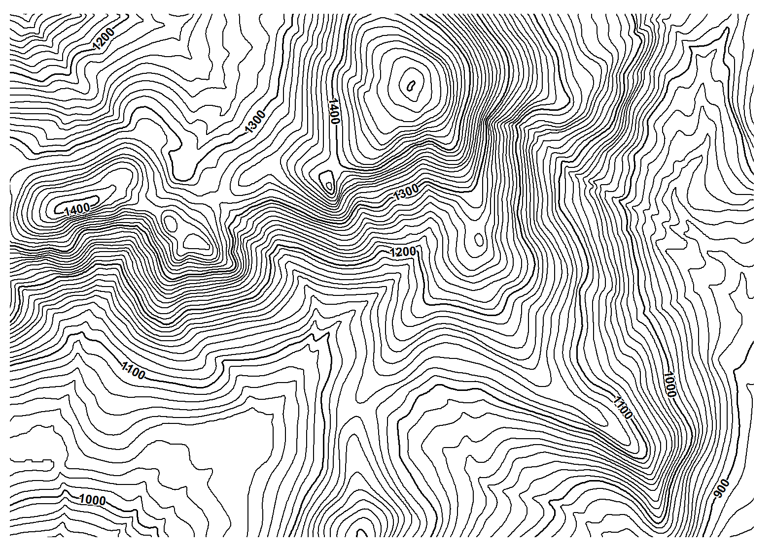
Isarithmic Map
© 2013 B. Tomaszewski

Slide 8
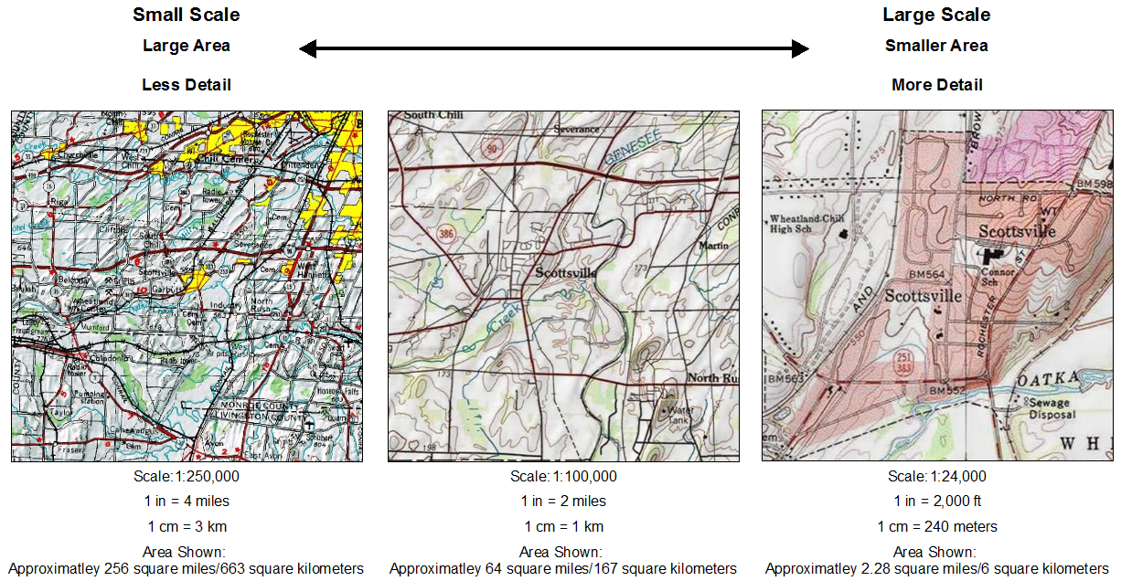
What is map scale?
© 2013 Brian Tomaszewski

Slide 9
Four Classes based on distortion
Conformal – preserves shape and angles
Equal Area (Equivalent) – preserves area and size
Equidistant – preserves distances in some directions
Azimuthal – preserves angles from a specific point
Notes:
Conformal – preserves shape and angles
Equal Area (Equivalent) – preserves area and size
Equidistant – preserves distances in some directions
Azimuthal – preserves angles from a specific point

Slide 10
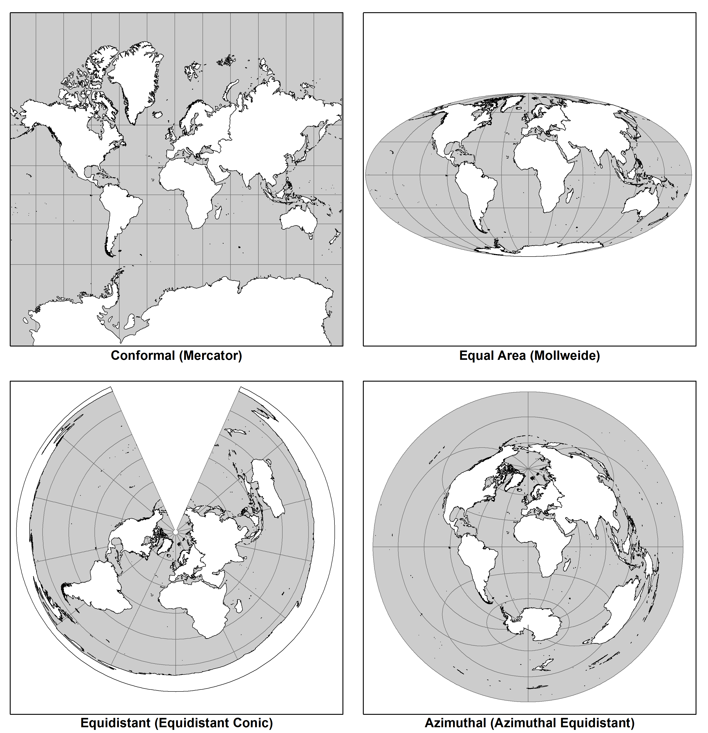
© 2013 Brian Tomaszewski

Slide 11
Which projections are most widely used?
True angle (conformal) projections for large scale maps and coordinate systems (UTM, SPCs)
True area (equal area) and compromise projections for small scale maps of the U.S. and world
True distance (equidistant) and true direction (azimuthal) projections for special projects.

Slide 12
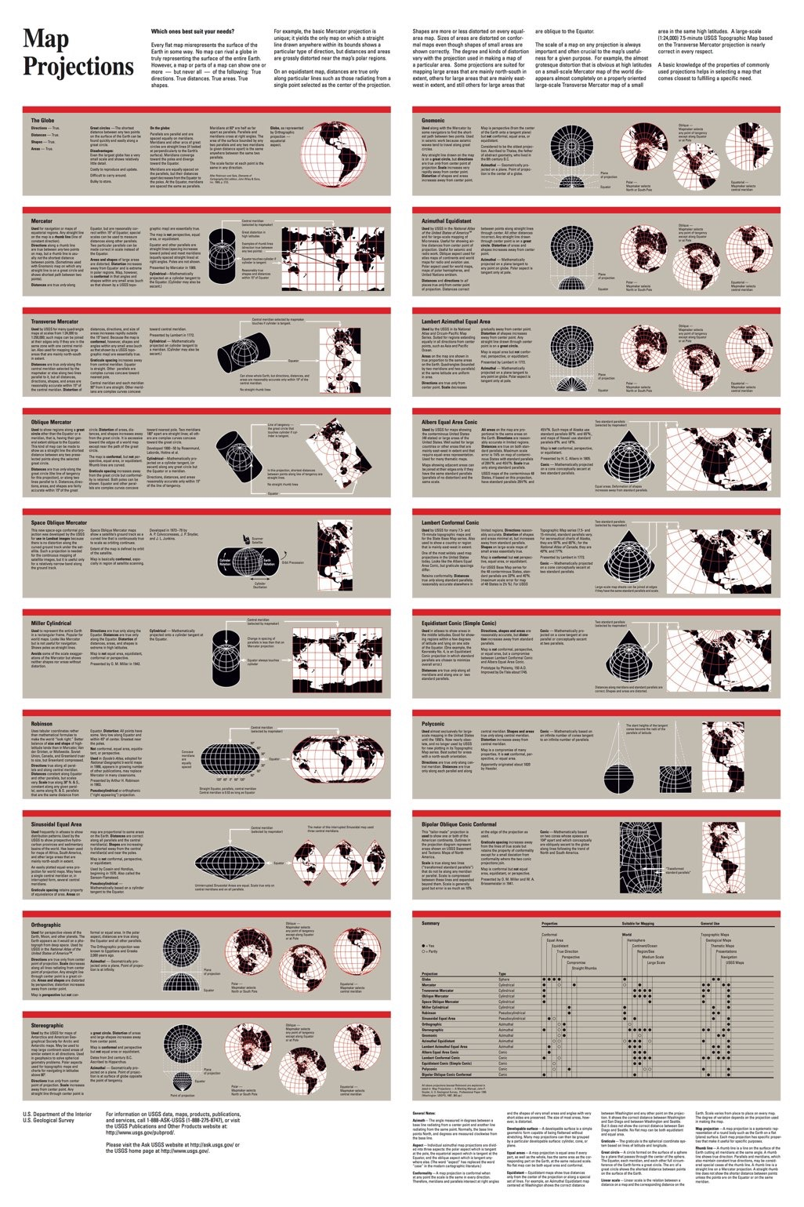

Slide 13
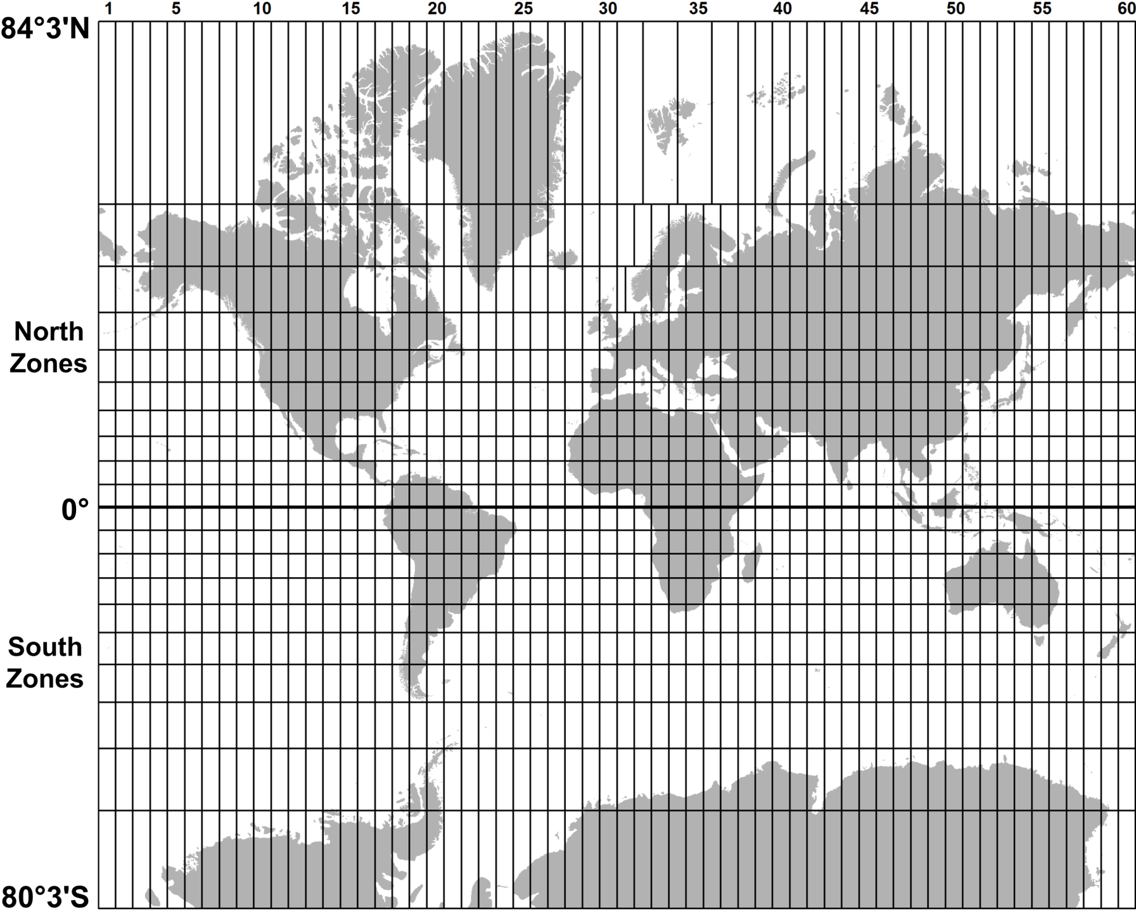
60 UTM zones (north and south)
© 2013 Brian Tomaszewski

Slide 14
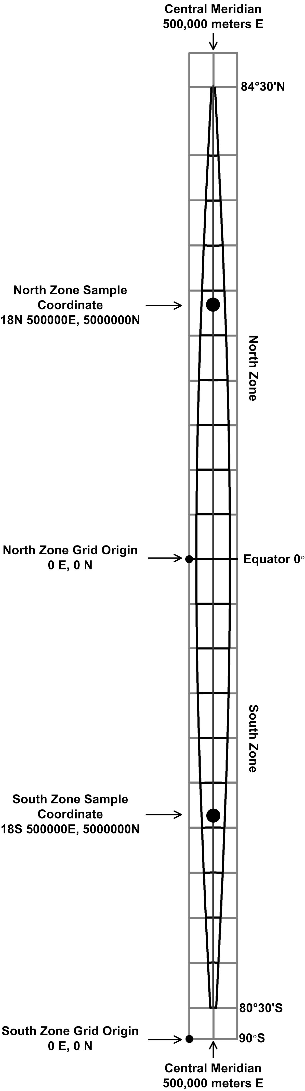
Characteristics of one UTM zone
Equator = 0m N for North Zone
Central meridian zone = easting of 500,000m E
A UTM coordinate = (1) the zone number, (2) the north or south hemisphere (N or S), (3) the six-digit easting (E) value and (4) the seven-digit northing (N) value. Sample Coordinate is: 18N 500000E, 5000000N
A whole zone
detail
© 2013 Brian Tomaszewski

Slide 15
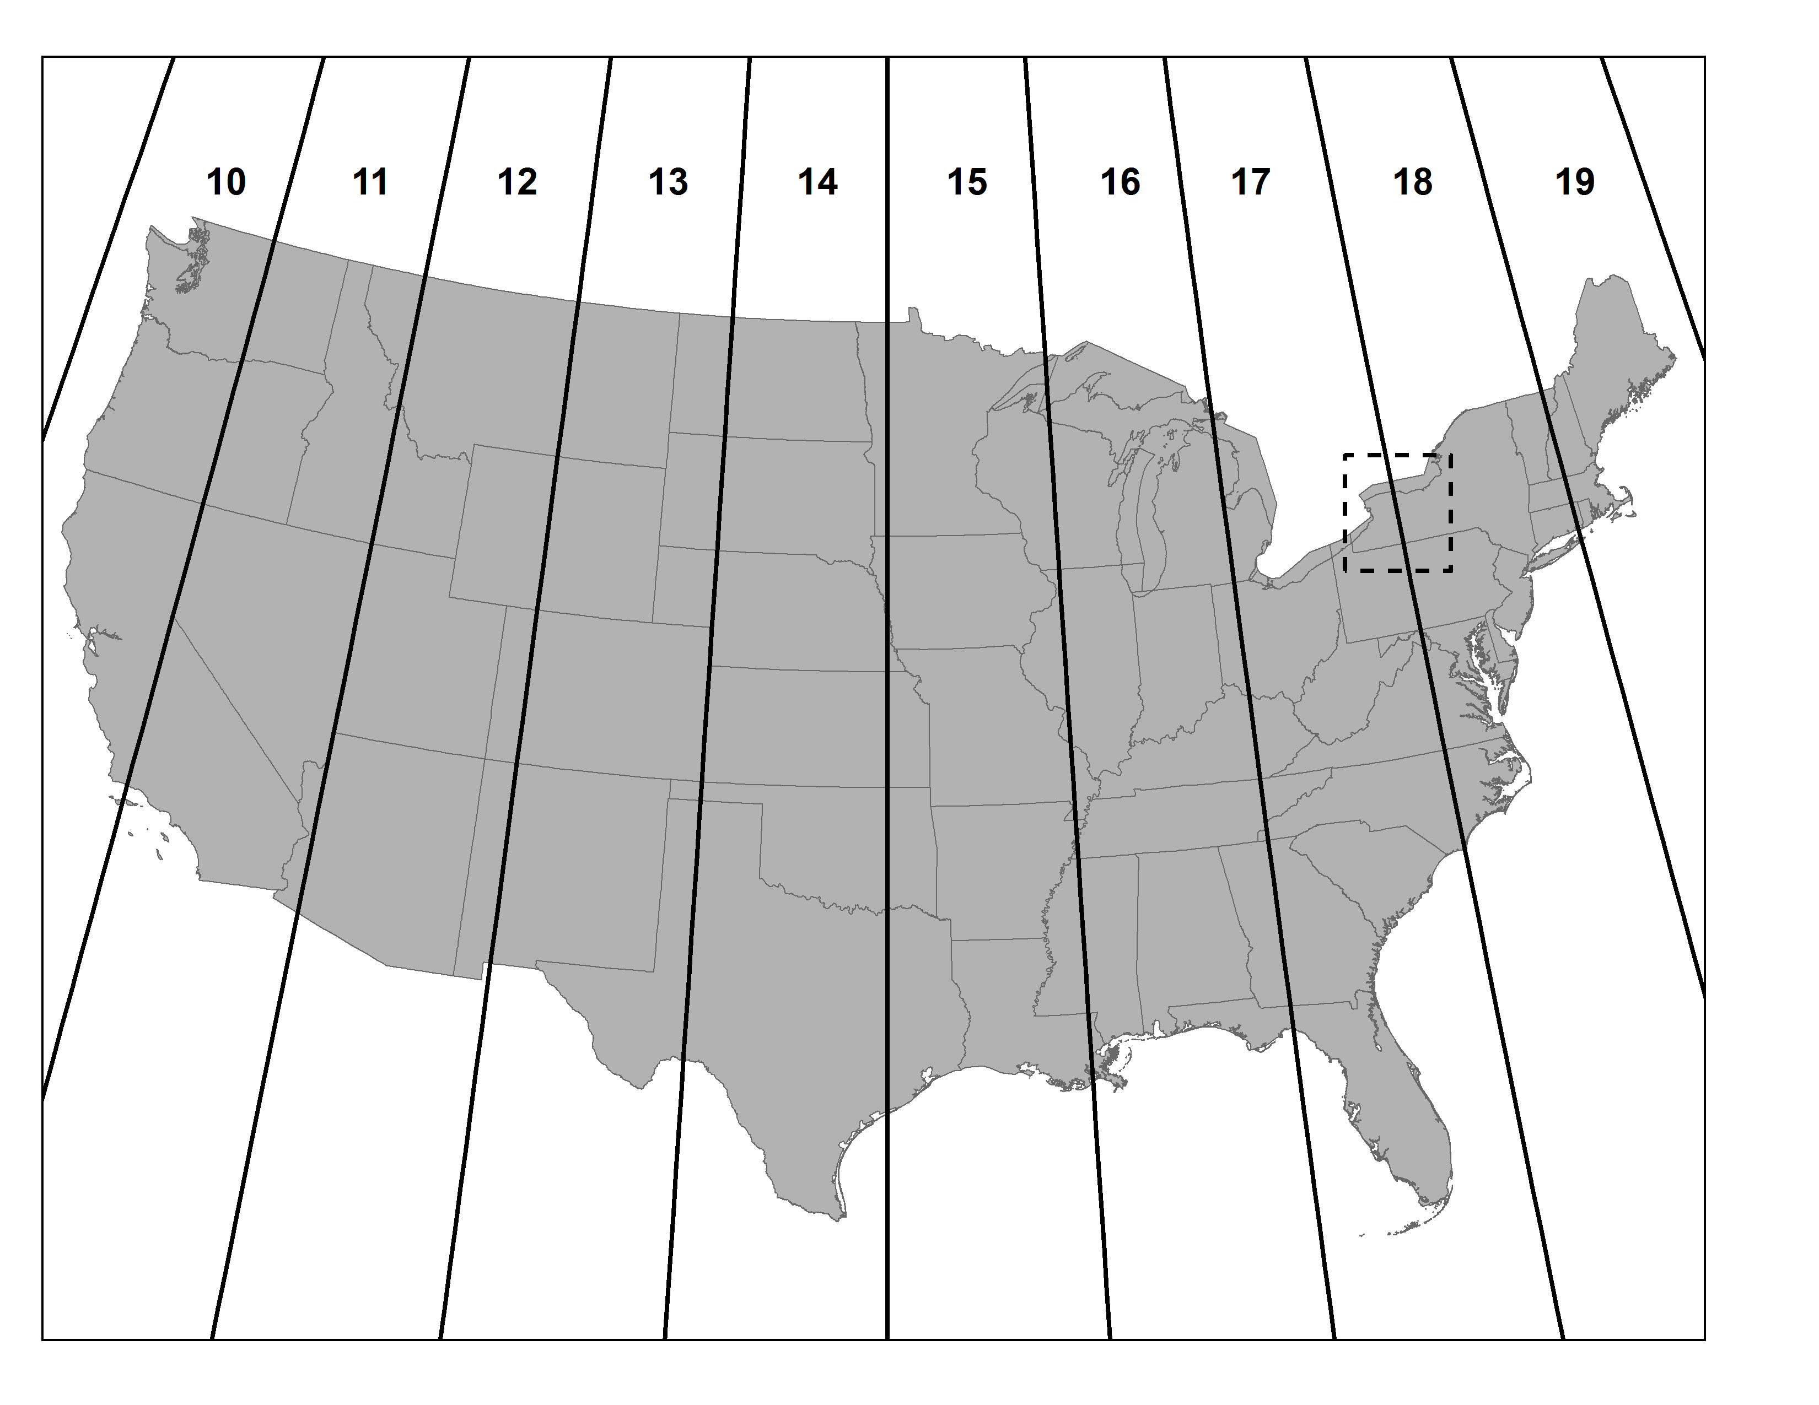
UTM Zones for the United States
© 2013 Brian Tomaszewski
Not perfect – Error. NY is divided….

Slide 16
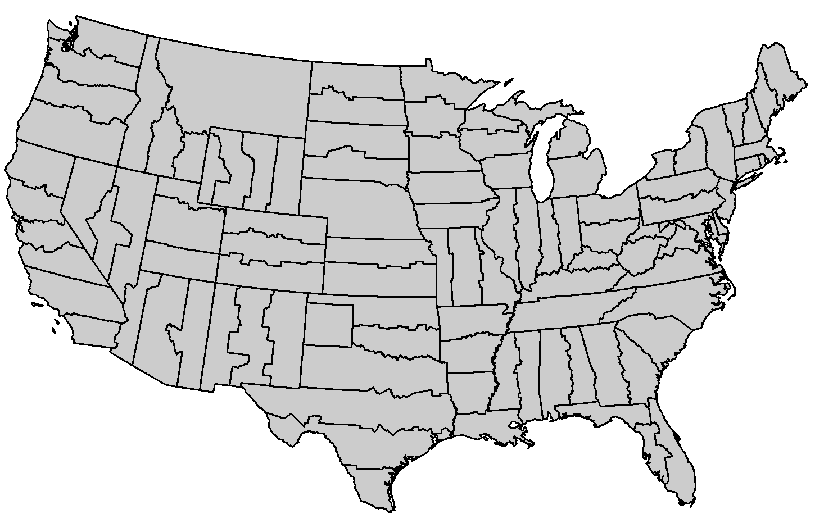
122 SPCs zones
State Plane Coordinate System
© 2013 Brian Tomaszewski

Slide 17
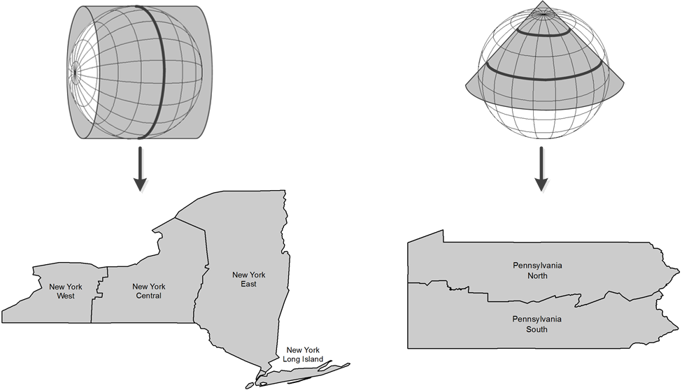
Map projections for SPCs zones
Transverse Mercator
(for
North-South regions)
Lambert Conic Conformal
(for
East-West regions)
Why? Distortion is zero along the central meridian
Why? Distortion is least along the standard parallels
© 2013 Brian Tomaszewski

Slide 18
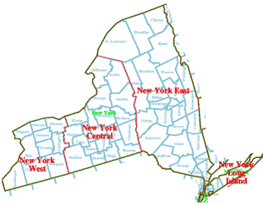
NYS SPC
http://www.vterrain.org/Locations/us/ny/sp_basemap_newyork.png

Slide 19
What is GIS?
Geographic Information Systems (GIS) are computer systems that enable people to integrate geographically-referenced data produced by various sources, to easily retrieve the data, and finally to produce information, often in the form of a map.
“GIS is to maps what the word processor has become for typewriters”

Slide 20
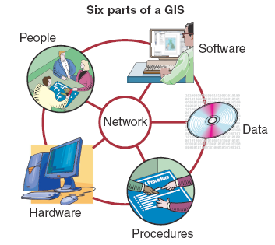
Organized collection of
Hardware
Software
Network
Data
People
Procedures
© 2005 John Wiley & Sons, Ltd

Slide 21
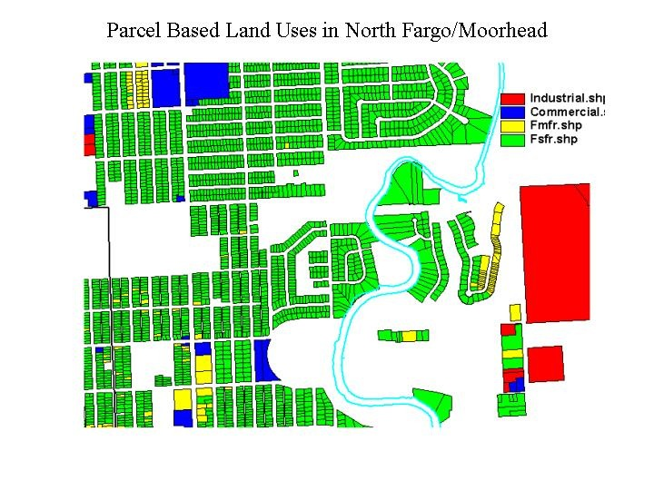
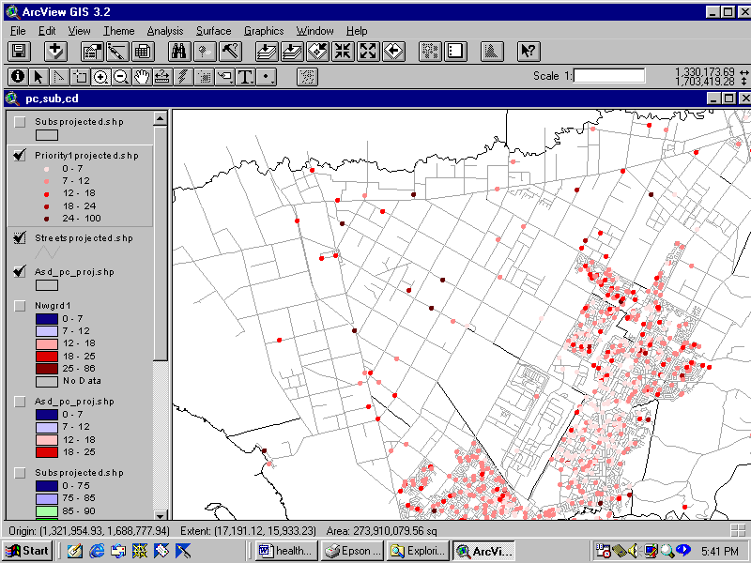
What GIS Can Do?
Integrate data from various sources
Edit and update data
Draw maps and visualize spatial distributions
Accurately measure distances and areas
Overlay maps (= compare)
Perform sophisticated analysis & modeling (what if?)
Notes:
With GIS we can easily:

Slide 22
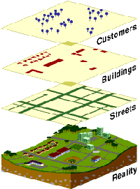
Data Integration
Combines layers of information (data) to have better understanding of a location
Satellite imagery
Photographic images
Maps
Tables (i.e spreadsheets)

Slide 23
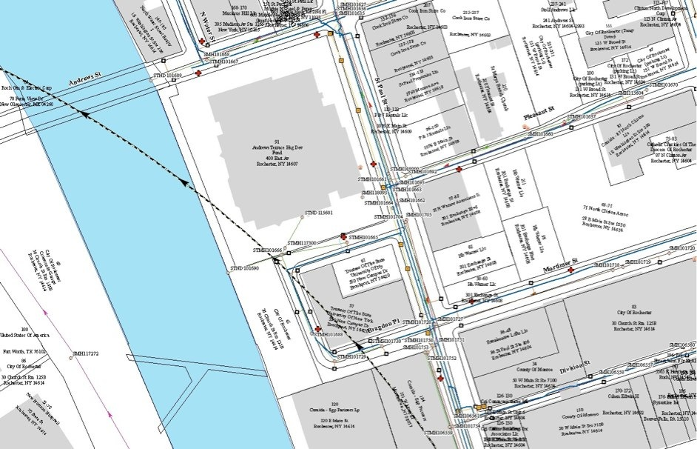
GIS Data Types
Two Main Types of GIS Data
Vector
Points
Lines
Polygons

Slide 24
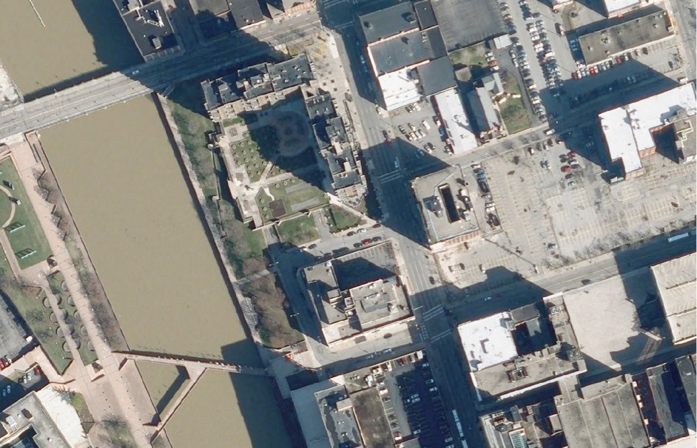
GIS Data Types
Two Main Types of GIS Data
Vector
Points
Lines
Polygons
Raster
Aerial Imagery
Weather Radar Imagery
Elevation Data
Lots of other types
Raster data is not the same as OSM or Google Maps tiles
Those are rasterized versions of GIS Projects to display faster, but do not have the same data characteristics as the original

Slide 25
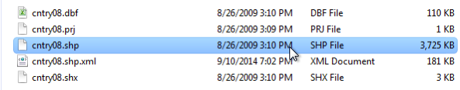
The Shapefile
We have been currently using shapefiles in class
These are spatial datasets which predate the geodatabse, but are still widely used
They only can store vector data
Cannot store curves
Made up of a lot of different pieces
2 Gigabyte Size Limit

Slide 26
Geodatabases
Geodatabases allow for data to be stored in single database
Can store tables, shapefiles, rasters, and annotation
Allows for the storing of true curves
In a personal geodatabase there is a 2 gigabyte limit
In a file geodatabase there is a 2 terabyte limit per feature class
Enterprise geodatabases have no limits
Must be created in ArcCatolog

Slide 27
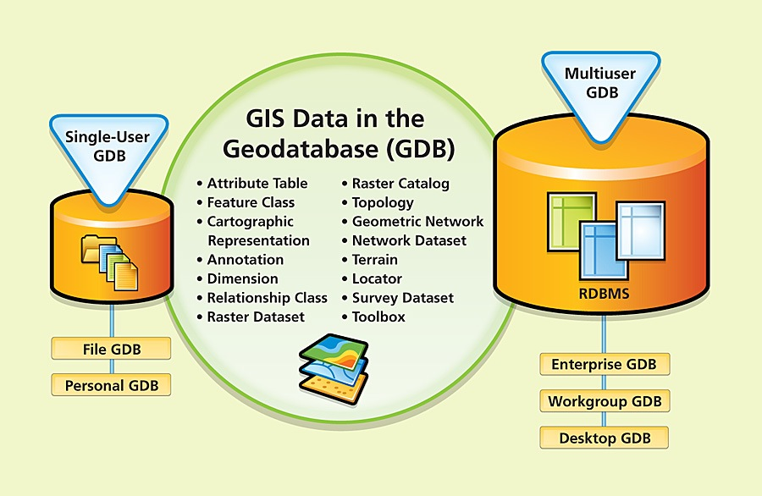
What is a Geodatabase?
http://www.esri.com/news/arcnews/winter0809articles/winter0809gifs/p1p2-lg.jpg

Slide 28
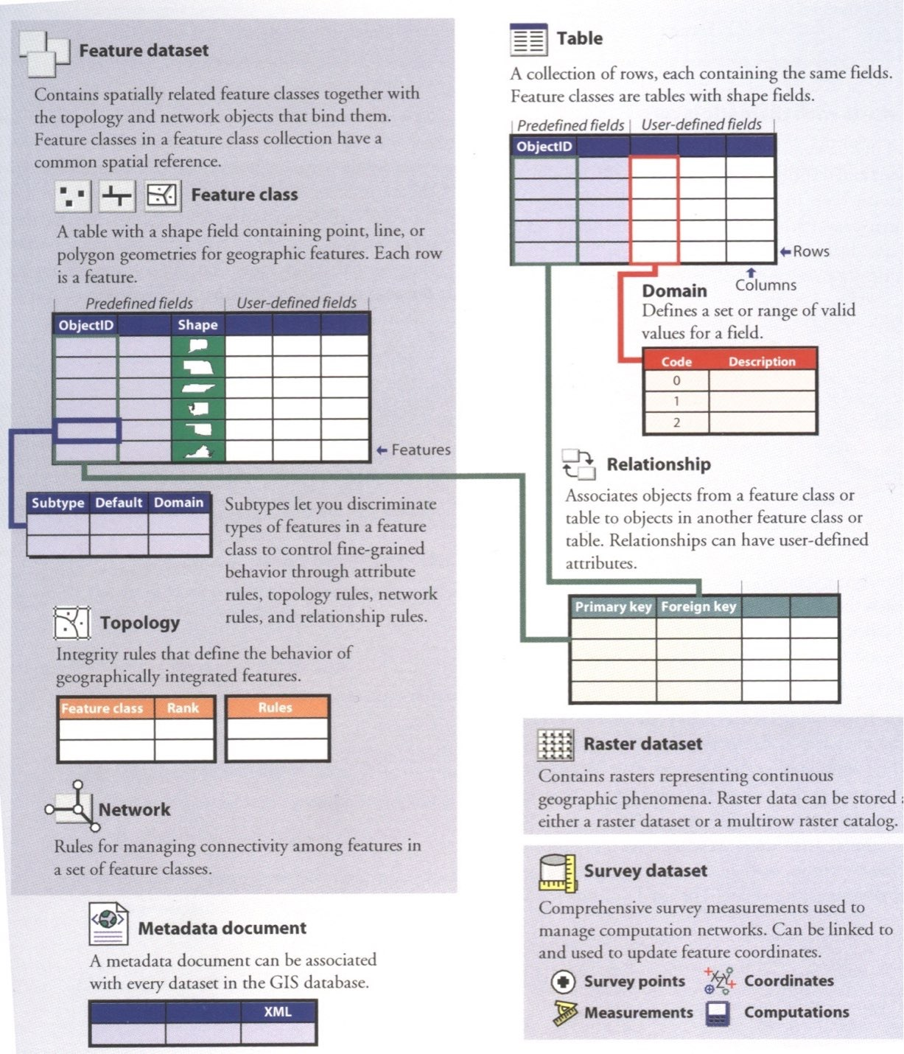
Overview of Geodatabase Architecture
From Arctur(2004)

Slide 29
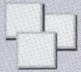
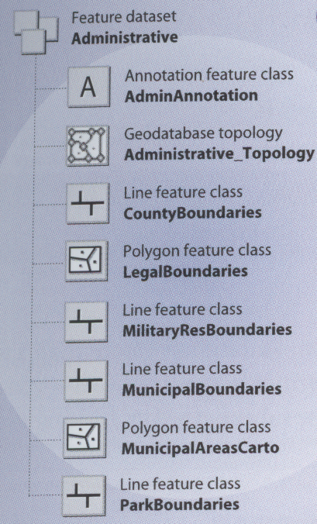
Feature Dataset
Contains spatially related features
A logical organization container
Notes:
Calgary – Address FDS, Administrative, Census 200 etc

Slide 30
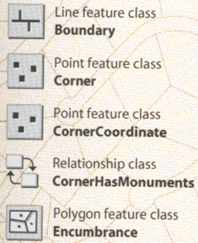
Feature Class
The primary storage for spatial data
Standalone and part of feature dataset
Notes:
Many feature classes in Calgary

Slide 31
Querying and Selecting Data
Query – ask a question
Many ways to query data in ArcMap
Identify tool
Using a graphic
Select by Location
Select by Attribute
Find tool

Slide 32
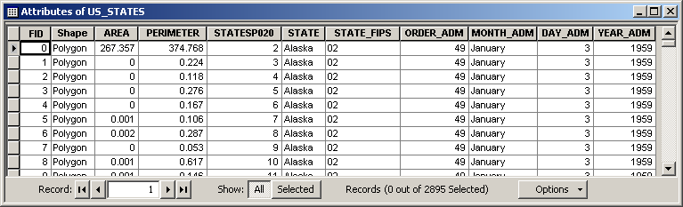
Query Basics
SELECT * FROM US_STATES WHERE STATE = ‘Alaska’
“where the value of the STATE column is equal to the value ‘Alaska’”
“give me everything from the table US_STATES”

Slide 33
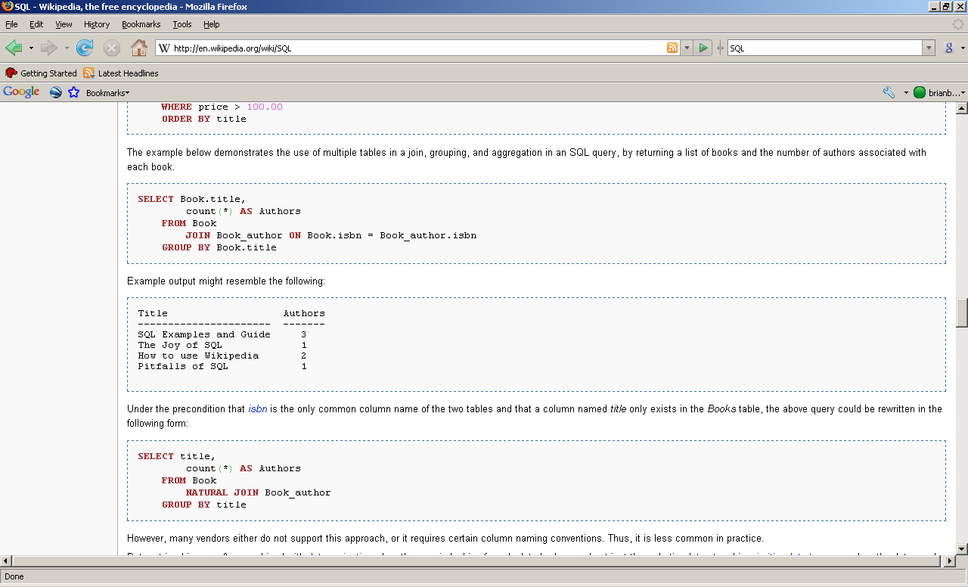

SQL
Structured Query Language
Used Implicitly and Explicitly in ArcGIS
Combine tables, fields, operators, much more..

Slide 34
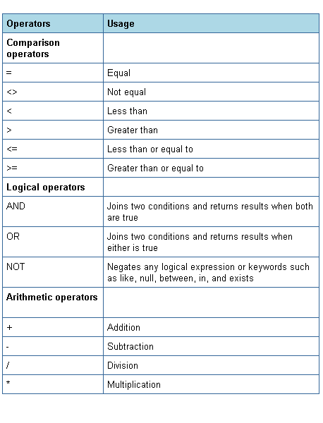
SQL WHERE Operators
http://iuiedocs.oes.indiana.edu/images/operators.png

Slide 35
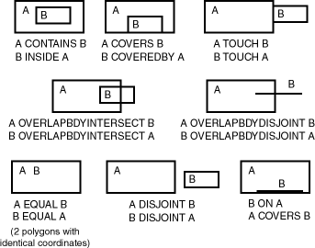
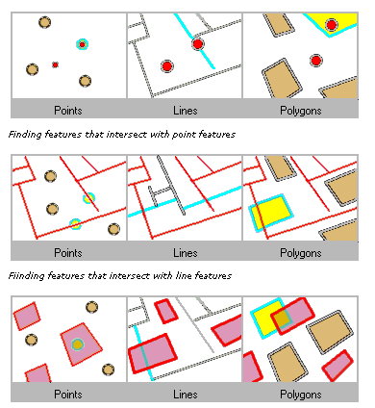
Spatial Operators for Querying
http://www.stanford.edu/dept/itss/docs/oracle/10g/appdev.101/b10826/top_rel.gif
Intersect Example
Non-exhaustive list
See ArcGIS Help Topic “Select By Location dialog” for more info
Used as a “spatial” WHERE clause

Slide 36
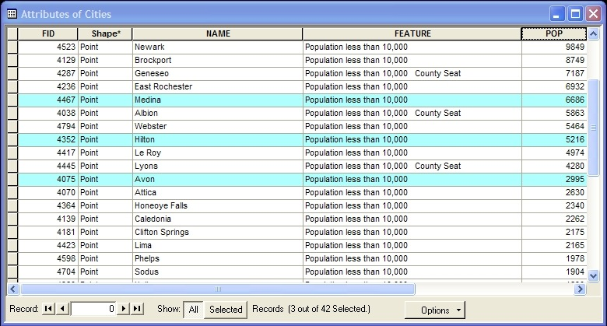
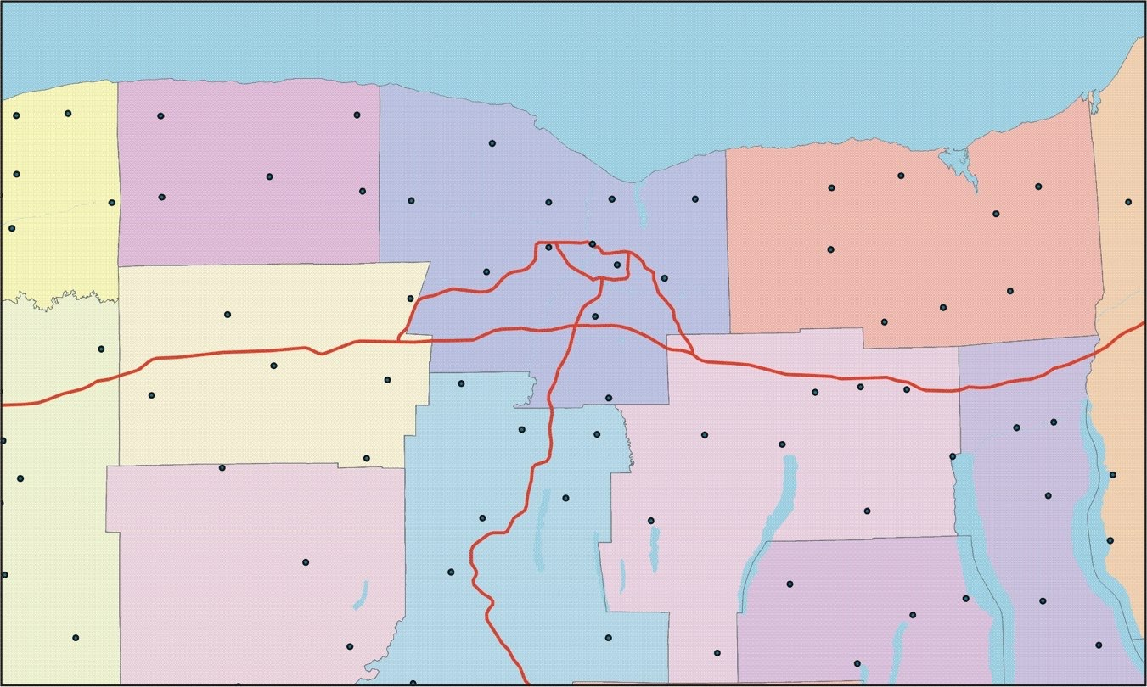
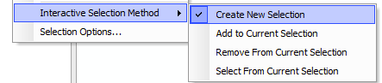
Interactive Selection Tool

Slide 37
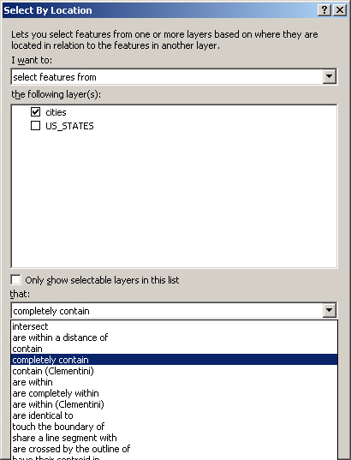
Select by Location
Uses Spatial Operators

Slide 38
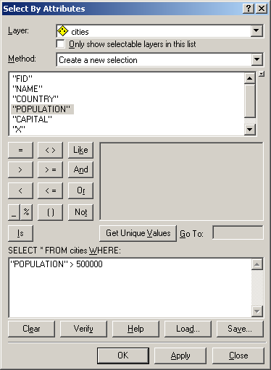
Select by Attribute
Build the WHERE part of query
Full query being built

Slide 39

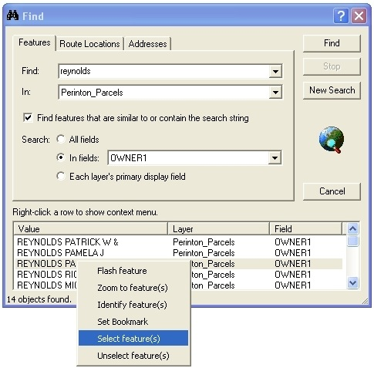
The Find Tool

Slide 40
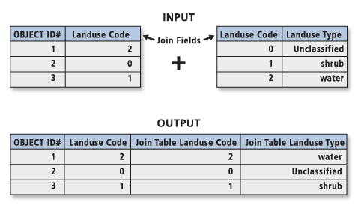
Table Join
“Appending the fields of one table to those of another through an attribute or field common to both tables. A join is usually used to attach more attributes to the attribute table of a geographic layer.”
Notes:
When you join two tables, you append the attributes from one onto the other based on a field common to both.

Slide 41
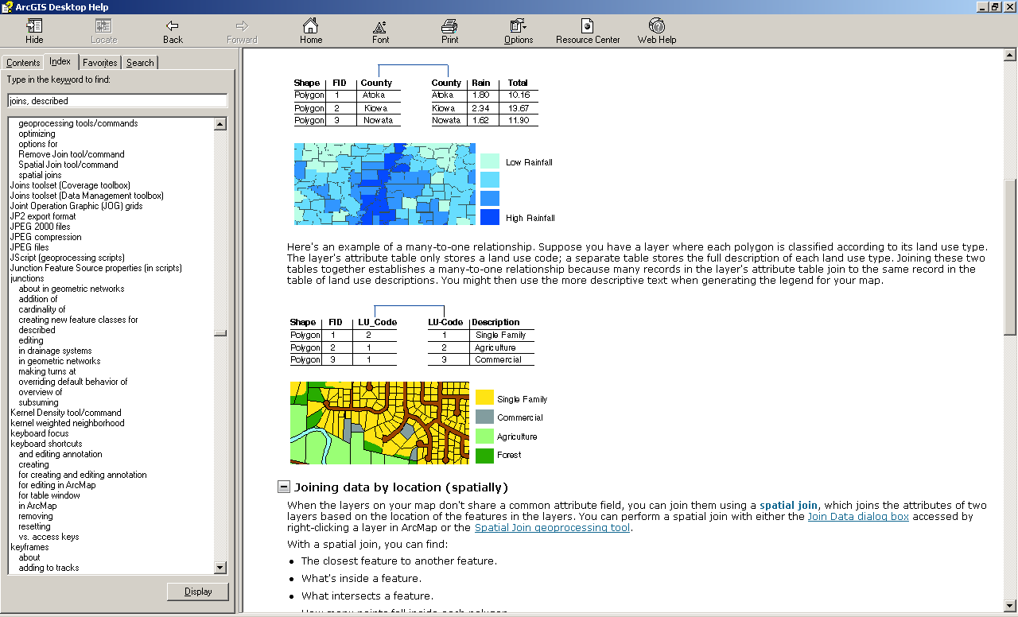
Join on number
Join on string (text)

Slide 42
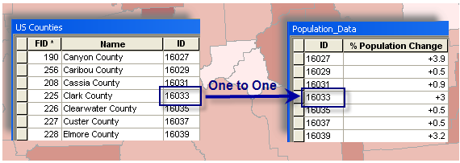
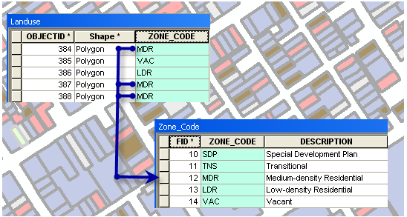
One to Many
Notes:
Caution:
If you try to create a join on a 1:M relationship, only the first match will be joined in the resulting joined layer.

Slide 43
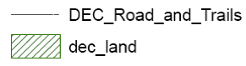
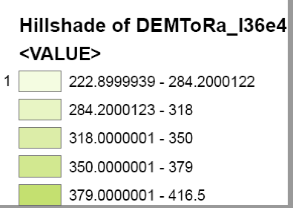
Things to Watch For
remove_underscores_from_titles_they_look_funny
round numbers so there aren't as many decimal places

Slide 44
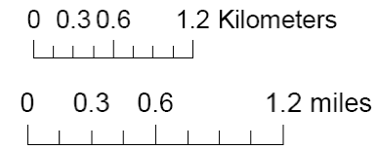
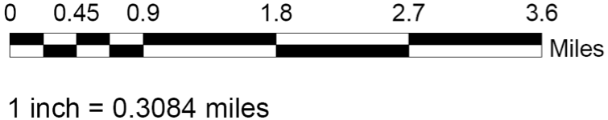
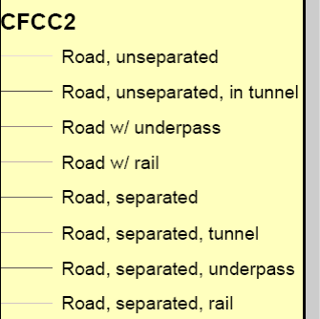
Things to Watch For
use even rounded numbers for scale bar increments. for example, end the graphic scale at 5 miles or 2.5 miles
use different sizes as well as colors to discern the various feature types (roads in this example), especially when you showing many classes, in this example, they are hard to understand. Also, make sure labels are intuitive – in this example, what does "road, unseparated" really mean? better classification would be "interstates, county roads etc
make sure your legend titles are meaningful and will be understood by someone other than you

Slide 45
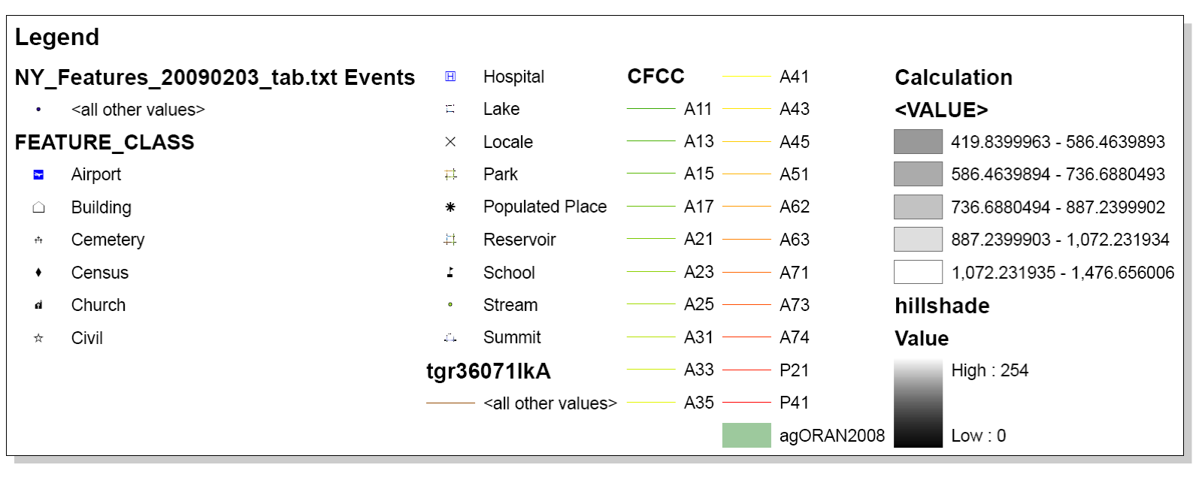
Things to Watch For
????
make sure all legend items are relevant
????
Is this needed?

Slide 46
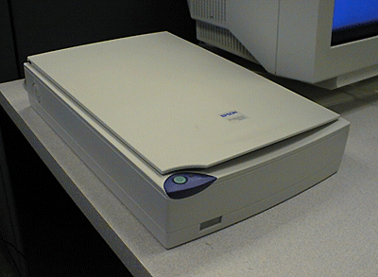
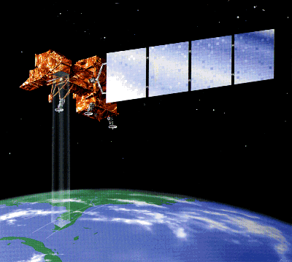
How do sensors record e.m. energy?
sensor = scanner = instrument
- energy source: reflected/emitted
- rows (raster)
- convert to electrical charge
- convert to digital data
Earth is big, curved, moving, has an atmosphere.
Distance, latitude, season (axis tilt), time of day (rotation) all have an effect.
Image Processing is required

Slide 47
What is resolution?
Spatial
Spectral
Radiometric
Temporal

Slide 48


What is spatial resolution?
- Measure of the fineness of detail visible in a remote sensing image
- Determines size of the smallest area that can be resolved by the sensor.
- Higher resolution images = sharper more detailed.
- Commonly expressed as pixel size in meters.
Think Raster Data cell size
Notes:
resolution is the least detectable difference in a measurement.

Slide 49


Spatial Resolution Example
Coarse Resolution
AVHRR-1.1km-MODERATE
GOES-25km-VERY COURSE
Fine Resolution
SPOT Panchromatic -10m
LANDSAT -30m

Slide 50


What is spectral resolution?
Spectral resolution or spectral sensitivity is :
Description of a sensors ability to discriminate fine spectral differences.
Smallest band or portion of the electromagnetic spectrum in which objects are discernable.
Specific wavelength intervals detected by a sensor
Notes:
Reference - http://www.ccrs.nrcan.gc.ca/resource/tutor/fundam/chapter2/04_e.php
Spectral resolution describes the ability of a sensor to define fine wavelength intervals. The finer the spectral resolution, the narrower the wavelength range for a particular channel or band.
Black and white film records wavelengths extending over much, or all of the visible portion of the electromagnetic spectrum. Its spectral resolution is fairly coarse, as the various wavelengths of the visible spectrum are not individually distinguished and the overall reflectance in the entire visible portion is recorded. Colour film is also sensitive to the reflected energy over the visible portion of the spectrum, but has higher spectral resolution, as it is individually sensitive to the reflected energy at the blue, green, and red wavelengths of the spectrum. Thus, it can represent features of various colours based on their reflectance in each of these distinct wavelength ranges.

Slide 51



What is radiometric resolution?
How good is the instrument at measuring small differences in the magnitude, or brightness, of radiation within the ground area corresponding to a single raster cell.
Radiometric resolution determines how fine the sensor can distinguish between objects of similar reflection. The higher the radiometric resolution, the better we can distinguish between even subtle differences in reflection.
The number of possible data values in each band.
magnitude
wavelength
Notes:
Radiometric resolution
http://en.wikipedia.org/wiki/Image_resolution#Radiometric_resolution
Radiometric resolution determines how finely a system can represent or distinguish differences of intensity, and is usually expressed as a number of levels or a number of bits, for example 8 bits or 256 levels which is typical of computer image files. The higher the radiometric resolution, the better subtle differences of intensity or reflectivity can be represented, at least in theory. In practice, the effective radiometric resolution is typically limited by the noise level, rather than by the number of bits of representation.
Analog dynamic range ,really bright differences can you docs, dynamix rbage

Slide 52


Another illustration of radiometric resolution
2-bit image
8-bit image
22 or 4 Shades of Gray
28 or 256 Shades of Gray

Slide 53

Temporal Resolution
How often the satellite system collects data of a particular area (repeat time)
Temporal Resolution
Every 16 Days
June 1, 2005
June 17, 2005
July 3, 2005

Slide 54

What is temporal resolution?
How frequently imagery is obtained for the same area.
Ability to collect imagery of the same area of the Earth's surface at different periods is critical
Spectral characteristics of features may change over time
Changes can be detected by collecting and comparing multi-temporal imagery.
The time factor in imaging is important when:
persistent clouds offer limited clear views of the Earth's surface (often in the tropics)
short-lived phenomena (floods, oil slicks, etc.) need to be imaged
multi-temporal comparisons are required (e.g. the spread of a forest disease from one year to the next)
the changing appearance of a feature over time can be used to distinguish it from near-similar features (wheat / maize)

Slide 55

Let’s look at both Spatial and Spectral resolution
Next five slides describe 3 Multispectral scanning systems: IKONOS, AVHRR, and Landsat.
A multispectral system collects data over a variety of different wavelengths, or bands.
Take note of both the spatial resolution and the spectral resolution of each.

Slide 56

What is “high” spatial resolution?

Slide 57


What is “low” spatial resolution?
Advanced Very High Resolution Radiometer
Notes:
AVHRR stands for "Advanced Very High Resolution Radiometer."
The data the sensors produce are widely used for large-area studies of vegetation, soil moisture, snow cover, fire susceptibility, and floods, among other things.
AVHRR sensors measure electromagnetic energy within five spectral bands, including visible red, near-infrared, and three thermal infrared. The visible red and near-infrared bands are particularly useful for large-area vegetation monitoring. The Normalized Difference Vegetation Index (NDVI), a widely used measure of photosynthetic activity that is calculated from reflectance values in these two bands, is discussed later.

Slide 58
What is “active” remote sensing?
Passive sensors: measure ‘naturally occurring’ radiation
Active sensors: emit their own radiation and measure the reflection
The IKONOS, AVHRR and Landsat instruments are passive sensors; they only measure radiation reflected or emitted by objects.
When it comes to the reflected visible and the near infrared bands there are two shortcomings suffered by passive sensors:
Cloud cover blocks these wavelengths
Only measurable in daylight hours
Longwave radiation (e.g., microwaves) can penetrate clouds.
But objects on the surface of Earth do not emit enough microwaves to be easily detectable from space.
So, active remote sensing systems have been created.

Slide 59


What is “active” remote sensing?
SRTM - Shuttle Radar Topography Mission

Slide 60





What is “active” remote sensing?
LiDAR - Light Detection And Ranging
http://www.csc.noaa.gov/products/sccoasts/html/tutlid.htm

Slide 61


GPS Gives Us Positions on Earth
Longitude and latitude - angles measured relative to the plane of the Prime Meridian and equator, respectively (analogous to x,y)
Angles are measured in degrees (degrees, minutes, seconds (DMS) or decimal degrees).
Surface expression of longitude and latitude - graticule of meridians and parallels
GPS Components need to know where they are relative to this geographic, or spherical, coordinate system.
Remember that this coordinate system is defined based on a datum.
Notes:
Longitude and latitude are angles measured relative to the plane of the Prime Meridian, and to the plane of the equator, respectively. (analogous to x,y)
The angles are measured in degrees (expressed as degrees, minutes, seconds (DMS) or as decimal degrees).
The surface expression of lines of longitude and latitude form a graticule of meridians and parallels, respectively.
So, the components of the GPS need to know where they are relative to this geographic, or spherical, coordinate system.
But, remember that this coordinate system is defined based on a datum.

Slide 62

GEOGRAPHIC Coordinate Systems
43° 4’ 31”
is the same as
43.0753 °
Measured in:
degrees, minutes, seconds
decimal degrees
1 Degree = 60 Minutes
1 Minute = 60 Seconds
No limit on accuracy
Notes:
Since no map projection is involved, there is no limit to the accuracy with which positions can be specified (apart from the practical limitations imposed by measurement instruments, storage media, and human operators)

Slide 63



What is GPS?
A system to calculate a position or coordinate on the Earth’s surface

Slide 64



Multi-Satellite Ranging
A 3rd range constrains user to 1 of the 2 points.
Which point is determined by “sanity” – 1 point obviously wrong.
1 range puts user on the spherical face of the cone.
Intersecting with a 2nd range restricts user to the circular arcs.
Pictures courtesy http://giswww.pok.ibm.com/gps

Slide 65



Accuracy of different types of GPS units
Low end (recreational grade)
$100-$400
Accuracy: 10-20 feet
Mid Range (mapping grade)
$2,500 - $10,000
Accuracy: 2-5m, sub-meter real-time, centimeter accuracy with post-processing.
High end (survey grade)
$10,000 - $25,000
Accuracy: sub-meter to centimeter real-time, sub centimeter accuracy with post-processing.

Slide 66
What accounts for inaccuracies?
Atmosphere (10 meters)
Orbit Error (5 meters)
Electronic “noise” (meters)
Clock Error (meters)
Multipath error (meters)
Receiver error (any size)
Geometric effects (Dilution Of Precision)
Operator error (to 100s of meters)

Slide 67

What accounts for inaccuracies?
Atmospheric Delay
Satellite signal bounces around traveling through the ionosphere and the troposphere.
Increases time to reach Earth,
Alters calculated position.
Notes:
The GPS satellite signal bounces around when traveling through the ionosphere and the troposphere. This increases the time it takes to reach the Earth, which alters the calculated position

Slide 68




What accounts for inaccuracies?
Multipath
GPS signal is reflected off objects before reaching receiver
Multipath
No multipath

Slide 69


What accounts for inaccuracies?
Obstruction
Landscape features block the GPS signals
Schedule your data capture during a time when you maximize the number of visible satellites
??
GPS does not work very well in areas with too many obstacles (Forests, cities, steep mountains)

Slide 70


What accounts for inaccuracies?
Positional Dilution of Precision (PDOP)
GIS Fundamentals, Paul Bolstad, 2002
Notes:
PDOP is a unitless measure that indicates when satellite geometry will provide the most accurate results
Satellites spread around the sky gives the best result

Slide 71

Geocoding
Geocoding is taking a table of addresses and placing them on the map
You need 3 things to geocode properly
Reference Data
Table to Geocode
Address Lookup (Index File)
Our Reference Data is going to be centerlines

Slide 72
Introduction to Census Data
The Census is taken every 10 Years and is a requirement of the Federal Government
The data determines a lot of important decisions such as;
Aid
Representation
Potential taxes (School Districts)
The data is provided in many different sizes

Slide 73

Census Data
Spatial (In Descending Size Order)
State
Division (County)
Town
Place
Tract
Block Group
Block
Blocks make up all of the information from each larger area
Tabular

Slide 74

Census Data
Spatial (In Descending Size Order)
State
Division (County)
Town
Place
Tract
Block Group
Block
Blocks make up all of the information from each larger area
Tabular

Slide 75
Geographic Size Matters
Some Analysis need very detailed data (blocks) for small edits
Voting Districts
Block Groups are for slightly larger
Census Tracts are widely used for analysis due to their size and easy to report the data
Most grant projects report using the census tracts
The census data does not go to individual house level due to privacy concerns

